Slide 1
Patient Diagnosis Report
SQL Script

Slide 2
Objective:
The database design helps to retrieve, update, and modify the patient’s details to keep track of the patient's health care routine.

Slide 3
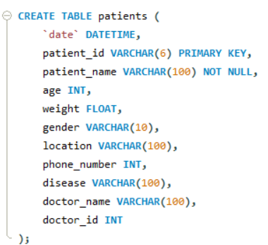
Write a query to create a patients table with the fields such as date, patient id, patient name, age, weight, gender, location, phone number, disease, doctor name, and doctor id.

Slide 4
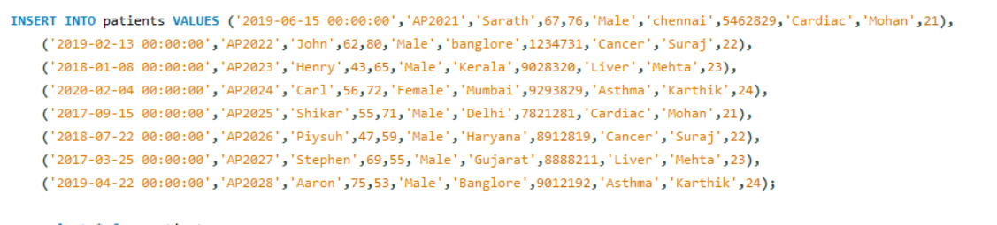
Write a query to insert values into the patients table.

Slide 5
Write a query to display the total number of patients in the table.

Slide 6
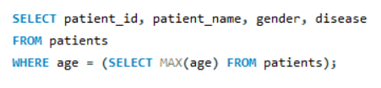
Write a query to display the patient id, patient name, gender, and disease of the patient whose age is maximum.

Slide 7
Write a query to display patient id and patient name with the current date.

Slide 8
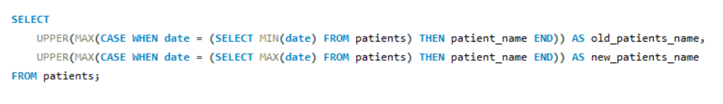
Write a query to display the old patient’s name and new patient's name in uppercase.

Slide 9
Write a query to display the patient’s name along with the length of their name.

Slide 10
Write a query to display the patient’s name, and the gender of the patient must be mentioned as M or F.

Slide 11
Write a query to combine the names of the patient and the doctor in a new column.

Slide 12

Write a query to display the patients’ age along with the logarithmic value (base 10) of their age.

Slide 13

Write a query to extract the year from the given date in a separate column.

Slide 14

Write a query to return NULL if the patient’s name and doctor’s name are similar else return the patient’s name.

Slide 15
Write a query to return Yes if the patient’s age is greater than 40 else return No.

Slide 16
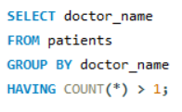
Write a query to display the doctor’s duplicate name from the table.

Slide 17
THANK YOU

